Slide 1

ML 101 Course
Arush Garg
AI and Machine Learning Club
Overseas Family School

Slide 2

Course (bit.ly/ML_101)
Introduction to Machine Learning (ML)
Regression
Core ML Concepts
Classification
Decision Trees
Model selection and tuning
Unstructured data: Text
Neural Networks
Unstructured data: Images
Introduction to Deep Learning
Beyond Regression & Classification
Notes:
Welcome back to ML 101 course. Today we are going to cover a very important topic that is Deep Learning

Slide 3
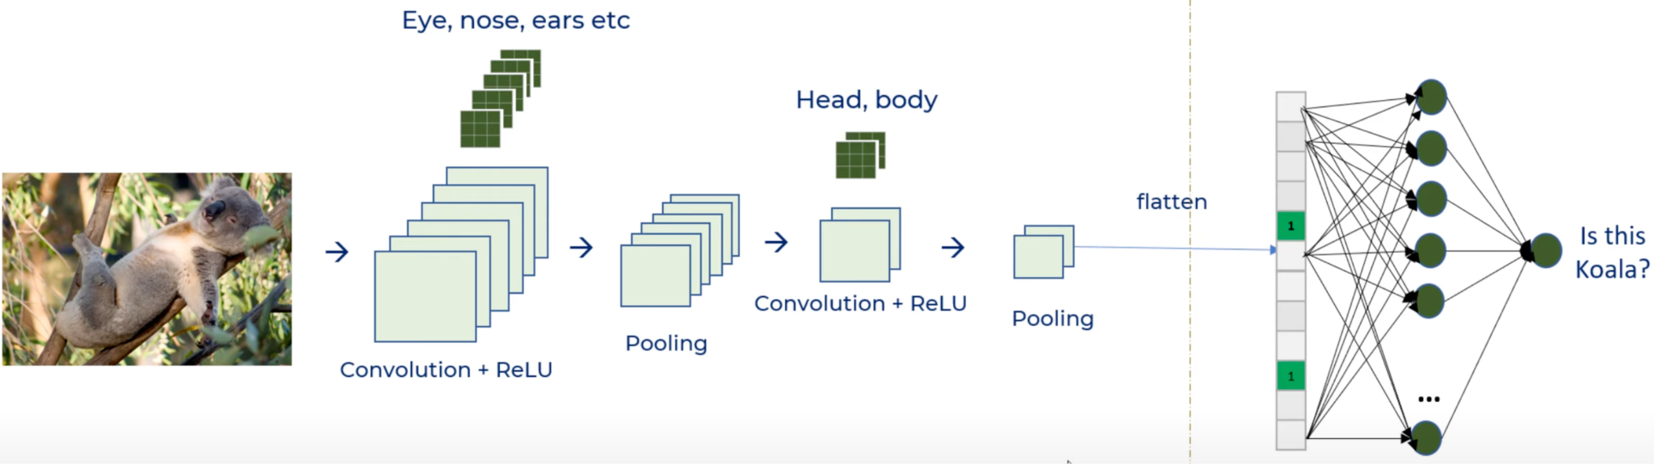
Recap
— Feature Extraction — Classification
Neural Networks
Interconnected network of neurons: Input layer to hidden layer(s) to output layer
ANNs = fully connected neural networks
# of parameters increase exponentially as we increase the # of hidden layers and # of neurons in a layer
NNs are very flexible as neurons can be connected in many different ways
CNNs (Convolutional Neural Networks)
Convolution Layer: Uses collection of filters to detect spatial patterns. Relu is a popular activation function
Pooling layer: Reduces output size significantly while preserving the key signal. Max pooling is most common
Every convolution layer is often followed by a pooling layer
A CNN model typically has multiple “convolution + pooling” layers in a sequence.
Initial convolution layers recognize simple features like edges, loops
Subsequent convolution layers assembles simple features to learn more complex features like head
Finally the output of last pooling layer is flattened and fed to a small fully-connected NN in order to make the final prediction
Notes:
Starting with a quick recap. Neural networks an an interconnected network of neurons organized into input, hidden and output layers. It’s a very flexible architecture and foundational building block of Deep Learning
Fully connected Neural Networks, also called ANNs pose certain limitations when used for Image classification task. CNNs address these problems by using convolution and pooling layers.
Convolution layer scans the input image using learnable 2D or 3D filters to detect and capture spatial patterns in the image.
In a typical CNN architecture there are multiple convolution layers. Initial convolution layers recognize simple features like edges & loops and as information passes through more layers, the subsequent convolution layers assembles these features to learn more complex features

Slide 4
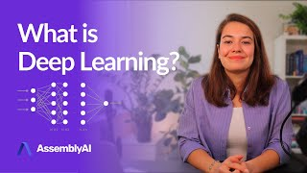
What is Deep Learning?
Deep = Multiple Hidden layers in the Neural Network model architecture
Traditional ML requires explicit “feature extraction” before the ML algorithm can be used.
In case of Deep Learning, as we saw with CNNs, the “feature extraction” task is done by the model itself.
Deep learning is extremely useful for unstructured data like images, text, videos etc.
Deep Learning typically requires significantly more training data, more processing power and takes much longer to train
AssemblyAI
Notes:
With CNNs we have already gotten a taste of Deep Learning. Now let’s understand what Deep Learning is further through this video.

Slide 5
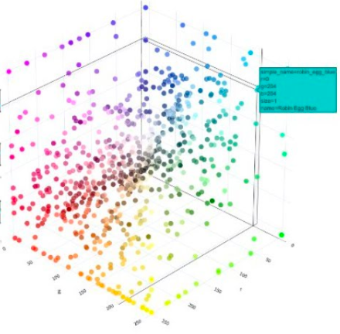
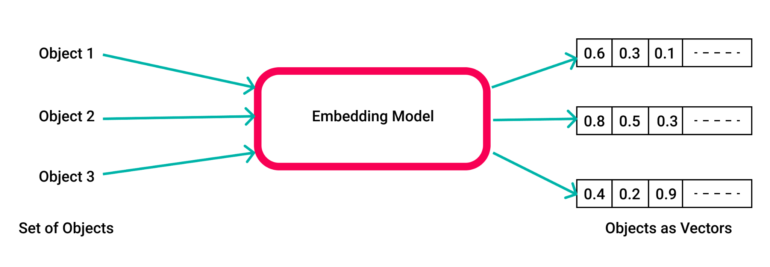
Embeddings
Image size 100x100x3
Flattened layer of size say 100
Using this CNN model, we converted a 100x100x3 image to to a vector of 100 numbers (flatten layer). This vector is called “image embedding”.
An embeddings is a dense semantic representation of the input in N dimensional space (N = 100 for this example)
Once the model is done training, two identical image inputs will result in generating the exact same “image embedding”
— Feature Extraction — Classification
As embeddings are “semantic representation” of the image for the given task, two images with small differences produce embeddings that are very close to each other in N-dimensional embedding space
This concept of embedding can be used for any kind of input. It is most commonly used for unstructured inputs like text and images.
3-Dimensional embedding space. Objects that are semantically similar will be closer to each other in this 3D space
Notes:
A very important and powerful concept of Deep learning is “embeddings”.
As we learnt in the last lesson, the sequence of convolution plus pooling layers act as “feature extractors” and the final output is flattened and fed to a fully-connected NN to make the prediction.
In this example, when we flattened the output of last pooling layer, we effectively converted our input image that was represented as a collection of RGB pixel values to a much smaller and dense feature vector of say size 100. This feature vector is the input image’s “embedding” in a 100-dimensional semantic space. It is like the image’s semantic signature.
The important characteristic of this semantic space is that, two images that are very similar to each other will have embeddings vectors pretty close to each other.
And this concept of embeddings can be extended to any input. Another very common application is text where we create word or sentence embeddings.

Slide 6
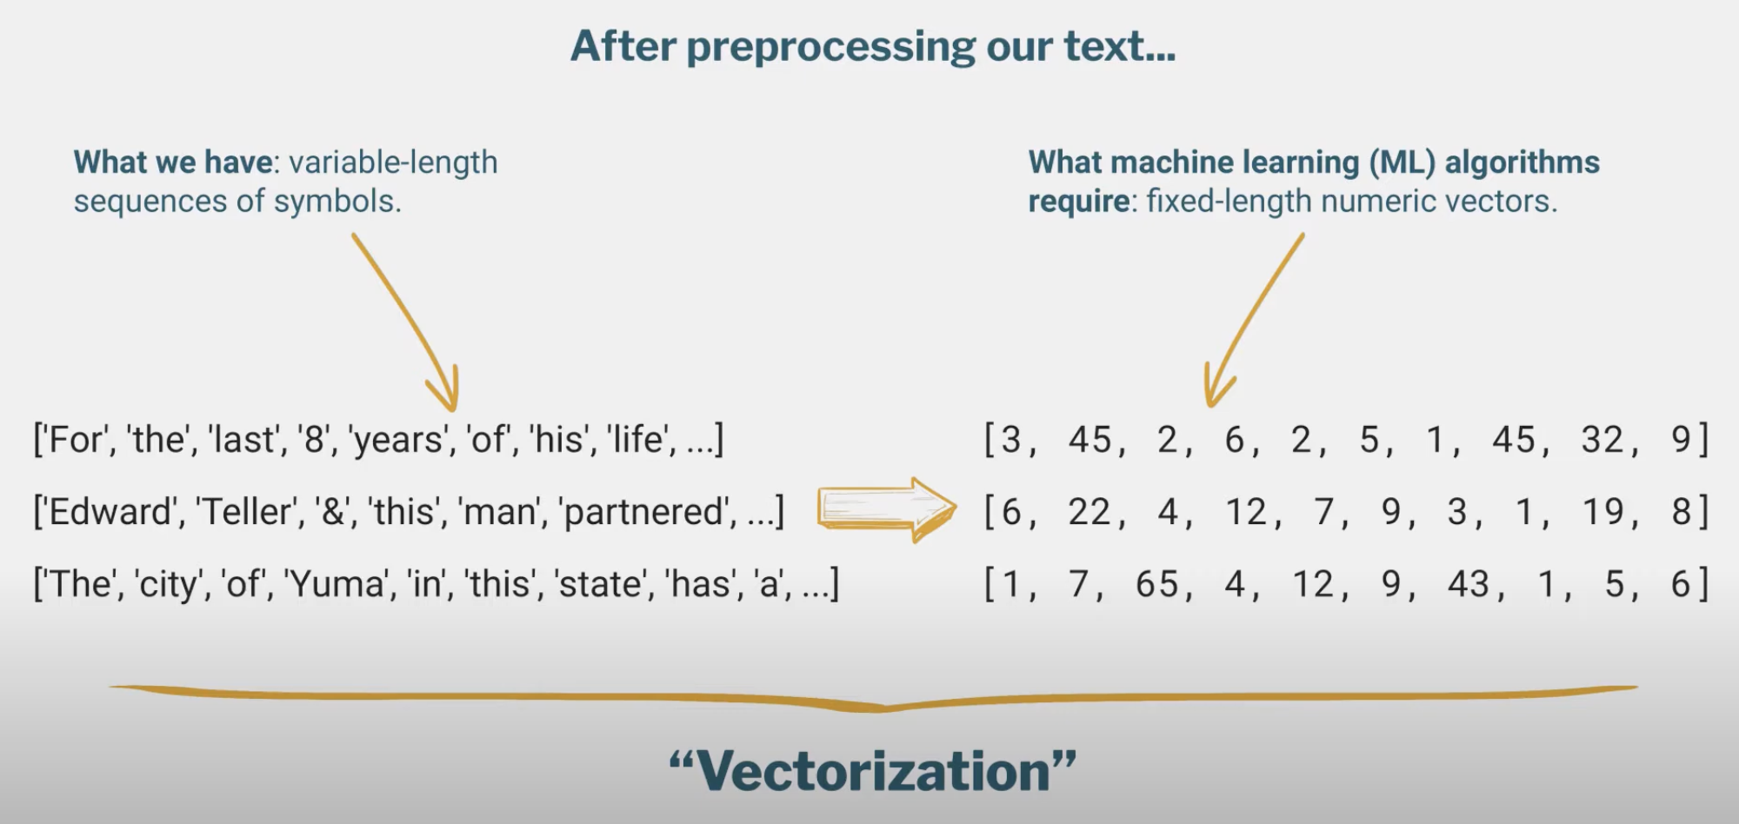
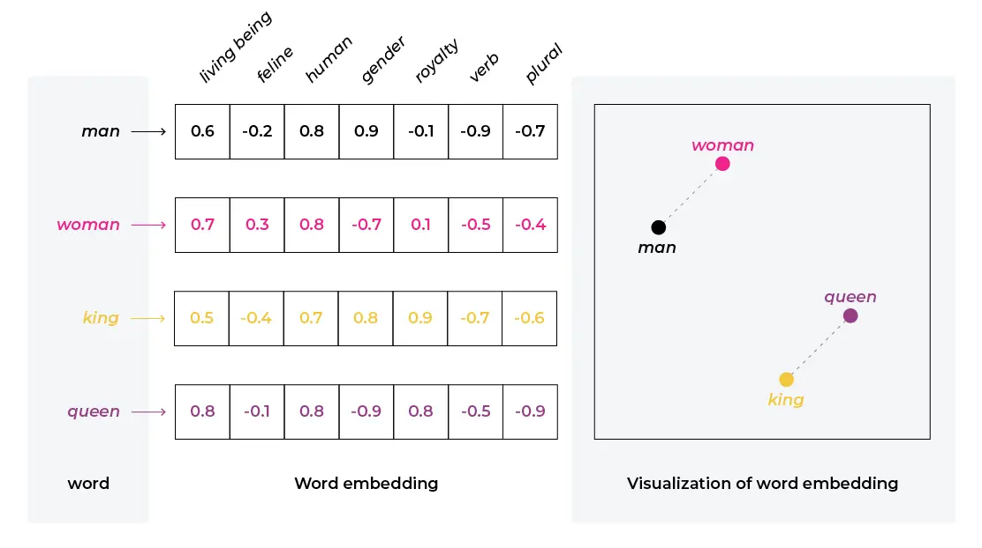
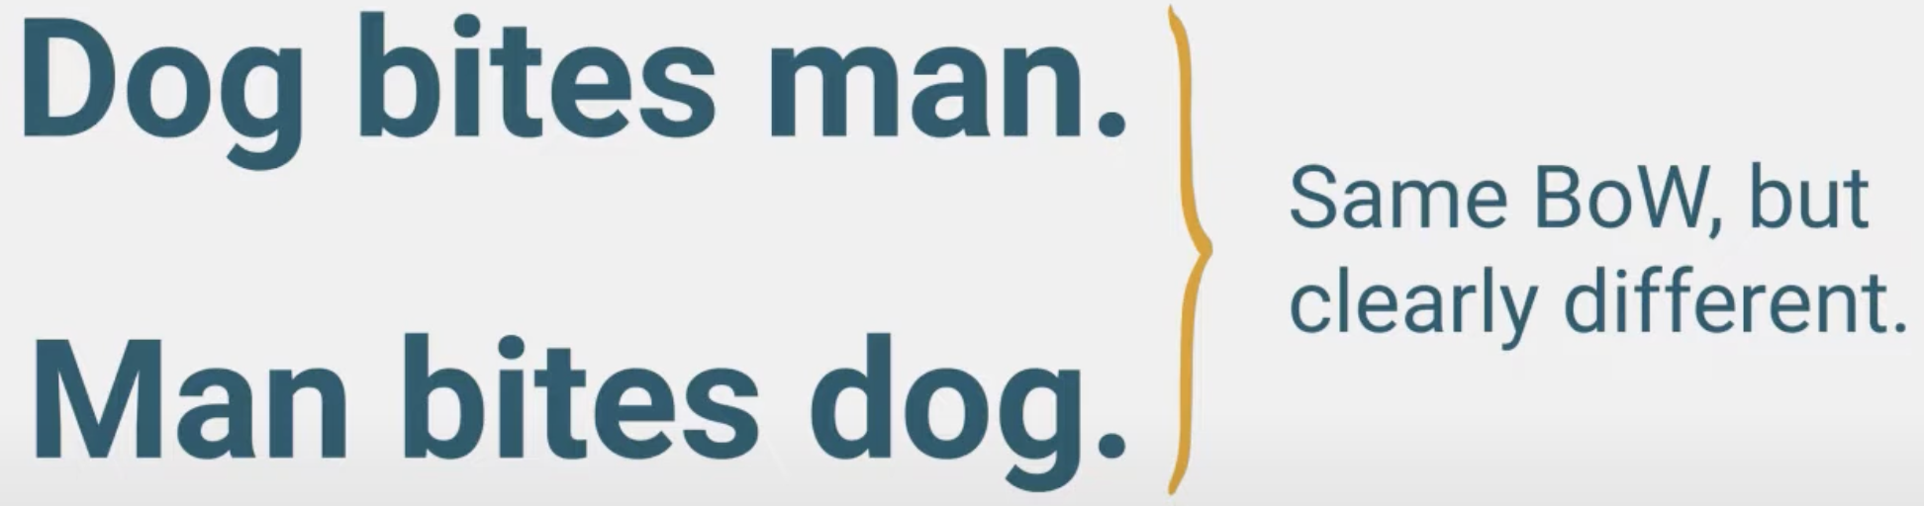
(Recap) Sentiment Classification
BOWs approach depends on simply the “presence” of a term or a phrase (bigram or trigram) in the input text. It does not “remember” in which order the terms/phrases appeared in the sentence.
Another approach is to create “word embeddings” and use word embeddings to create “sentence” embeddings. These fixed-length numeric embeddings can then be used as input features
If we only use unigrams
This works fine for many NLP tasks but has its limitations for tasks that require the knowledge and awareness of past context. E.g. auto-complete
Notes:
Earlier we had used bag of words approach to vectorize variable length sequence of terms to fixed length numeric vectors
We can also use word or phrase embedding vectors to train a sentiment classifier or for other Natural Language Processing tasks
(click)
But as you can imagine, these approaches have limitation because they only depend on the “presence” of a term or phrase. They do not preserve the order of tokens and do not do well for applications that depend on the context. E.g. auto-complete

Slide 7
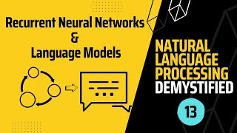
RNNs: Recurrent Neural Networks
Future Mojo - NLP Demystified
Notes:
Just like CNNs architecture helps leveraging the spatial image context, RNNs help with preserving the text context.

Slide 8
Introduction to Language Models & Text Generation
Future Mojo - NLP Demystified
Notes:
Now that we understand RNNs, let’s understand what is a Language Model and how RNNs can help generate text

Slide 9
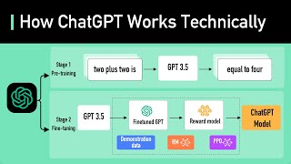
Large Language Models (LLMs): ChatGPT
ByteByteGo
Notes:
At the core ChatGPT is nothing but a super large language model.

Slide 10

Hands-on Exercises
Lesson 10 / Report.ipynb
https://bit.ly/ML_101
Notes:
In this week’s hands on exercise, we will do something, slightly illegal. We will learn how give ChatGPT an assessment task sheet and get it to generate a report for us. You will need to get an OpenAI API key, which you can get using the link the description below.

Slide 11
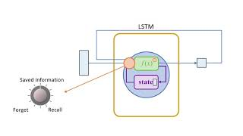


Further Reading / Watching / Doing
Practice notebook
Blue sky!
MATLAB: Intro to LSTM
Future Mojo - Playlist of NLP
Google Cloud Tech - Playlist of NLP
Notes:
For this week, I strongly recommend you experiment more with the OpenAI API key. Hence, there is no specific task to be completed. You can try using ChatGPT for some other purpose in your code, or try out new models altogether, like Dall-e.
To learn more about model memories and natural language processing, check out these videos.

Slide 12
Agenda for next class
ML beyond Supervised Learning
Clustering
Recommender Systems
Generative AI
Notes:
So far we have focused on classification and regression problems that are Supervised Learning problems.
But there are many interesting and important problems beyond Supervised Learning where ML can be of great benefit.
We will learn about those in the next video, which will also be the final video of this course.

